Slide 1
Stochastic Variational Inference
Reza Babanezhad
rezababa@cs.ubc.ca

Slide 2
Outline
VI
Monte Carlo Gradient Approximation
Stochastic Variational Inference(SVI)
Bridging the GAP

Slide 3
VI
VI can be used to approximate the posterior distribution
Objective is minimizing the KL divergence between the approximate q and joint distribution p
To optimize ELBO, we can use the coordinate descent or ascent.
Problems:
Computing the gradient of expectation
In each iteration, we need to go over all data.

Slide 4
Monte Carlo Gradient Approximation
In ELBO some expectations cannot be computed in closed form.
To solve it, let divide it to to part:
h : closed form part.
f : its expectation does not have closed form.
The gradient:
The first term in RHS is intractable.
Goal: finding a Monte Carlo approximation for intractable term.

Slide 5
Monte Carlo Gradient Approximation

Slide 6
SVI
Model
Our goal: approximate the posterior
Locally independence

Slide 7
SVI
Extra assumption
posterior is from exponential family
h: base measure
t: sufficient statistics
ƞ: natural parameter
a: partition function or log normalizer

Slide 8
SVI
Conjugacy relation between the global variable and local variable
Prior of global variable is also exponential
Posterior

Slide 9
SVI: Exp. Family
2 main properties:

Slide 10
SVI
Example of exp. family

Slide 11
SVI
Natural parameterization of Bernolli

Slide 12
SVI: ELBO

Slide 13
SVI: Mean Field VI
Mean field variational family
Our approx. dist. is from exp. family
Entropy term:
and denote expectation w.r.t. and

Slide 14
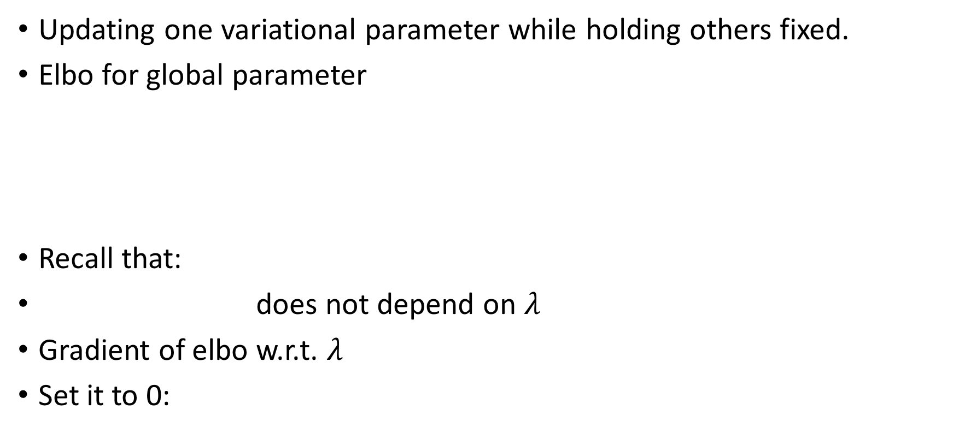
SVI: coordinate ascent inference
Updating one variational parameter while holding others fixed.
Elbo for global parameter
Recall that:
does not depend on $λ$
Gradient of elbo w.r.t. $λ$
Set it to 0:

Slide 15
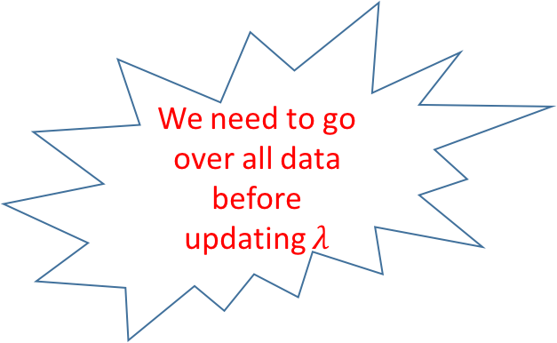
SVI: coordinate ascent inference
Similarly for local parameters
We need to go over all data before updating $λ$

Slide 16
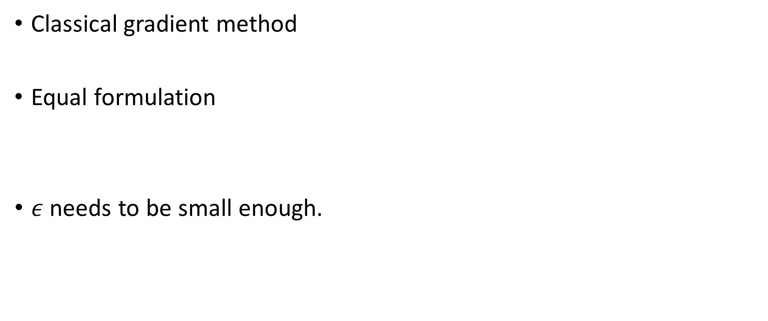
SVI: Natural Gradient
Classical gradient method
Equal formulation
$ε$ needs to be small enough.

Slide 17
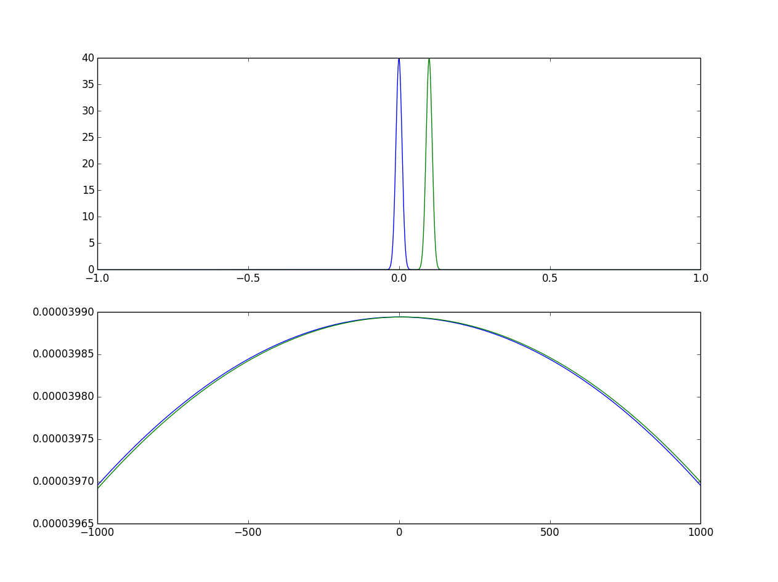
SVI: Natural Gradient
Which of these two distributions are more different?
Euclidian Distance = 0.1
Euclidian Distance = 10

Slide 18
SVI: Natural Gradient
Natural Measure of dissimilarity between probability measures:
Riemannian Metric :
Natural Gradient

Slide 19
SVI: Natural Gradient
Here, G is Fisher information matrix
We need to find G for exponential family.

Slide 20
SVI: Natural Gradient

Slide 21
SVI: Natural Gradient
Using natural gradient for variational parameters

Slide 22
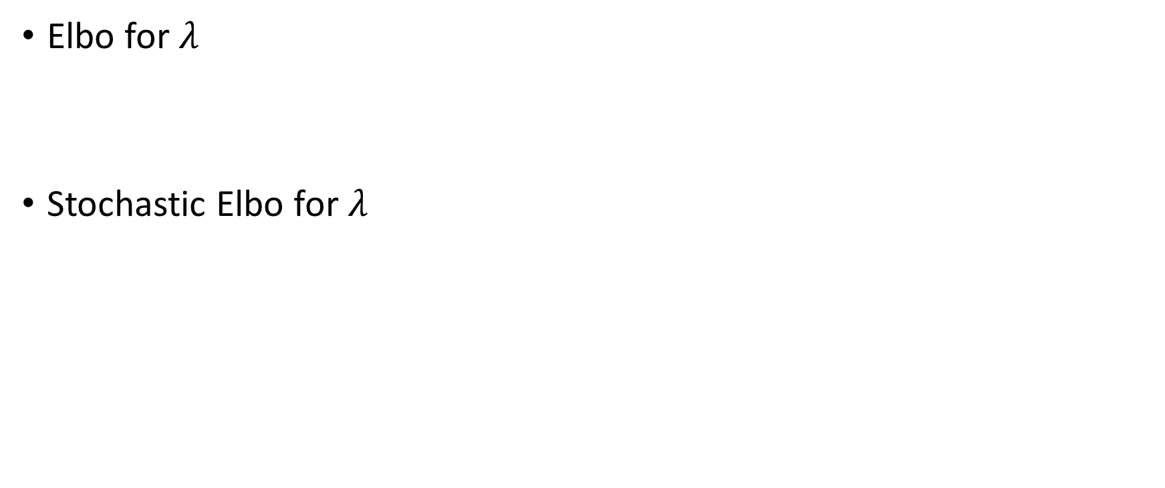
SVI: Stochastic elbo
Elbo for $λ$
Stochastic Elbo for $λ$

Slide 23
SVI: Stochastic Natural Gradient
Natural Gradient and update

Slide 24
SVI algorithm

Slide 25
Bridging the GAP
What if taking samples from posterior approximate is not easy?
Basic Idea:
Use monte carlo method to generate samples from posterior approximate.

Slide 26
Thank you!

